Slide 1

Rationale
Introduction to Windows Store App Development Using HTML5 and JavaScript
Computer science is a field of study that deals with solving a variety of problems by using computers.
  To solve a given problem by using computers, you need to design an algorithm for it.
Multiple algorithms can be designed to solve a particular problem.
An algorithm that provides the maximum efficiency should be used for solving the problem.
  The efficiency of an algorithm can be improved by using an appropriate data structure.
Data structures help in creating programs that are simple, reusable, and easy to maintain.
This module will enable a learner to select and implement an appropriate data structure and algorithm to solve a given programming problem.

Slide 2
Objectives
  In this session, you will learn to:
  Save the app state
Notes:
2

Slide 3
Saving and Restoring Session Data
  To save the session data:
  Write the code that saves the content in the oncheckpoint event handler of the default.js file.
  Ensure that your session data is saved before your app is suspended by saving data incrementally when the data is changed.
  To restore the session data:
  Check the previous execution state of the app.
  If the previous execution state is terminated, retrieve the session data.
Notes:
3

Slide 4
Saving and Restoring Session Data (Contd.)
  Saving session data:
  To save the session data for a particular page, write the code in the oncheckpoint event handler.
  Example:
    The following code snippet saves the text specified in a text box on the UI:
      WinJS.Application.sessionState.Name = document.getElementById("txtName").value;
Notes:
4

Slide 5
Saving and Restoring Session Data (Contd.)
  Restoring session data:
  To restore the session data, write the code within the onactivated event handler of the default.js file, for the apps created by using the Blank App template.
  To restore the session data for the apps created by using the Navigation App template:
    Save the previous execution state in the onactivated event handler of the default.js file.
    Write the code within the ready() function of the page to check the previous execution state of the app.
    If the previous execution state of the app is terminated, restore the session data.
Notes:
5

Slide 6
Saving and Restoring Session Data (Contd.)
Let us look at an example, which saves and restores the session data in an app
Notes:
6

Slide 7


Just a Minute
  Identify the event handler in which you can write code to save the session data for a page.
    1. oncheckpoint
    2. onactivated
    3. onchange

Slide 8
Just a Minute (Contd.)
  Solution:
    1. oncheckpoint

Slide 9
Demo: Saving and Restoring Session Data
  Problem Statement:
  Ryan has created the Shopping portal app, which displays the details of the various products manufactured by the company. In addition, it allows users to:
    Find the products by their type, such as Mobiles, Cameras, Laptops, Tablets, and Television Sets.
Notes:
9

Slide 10
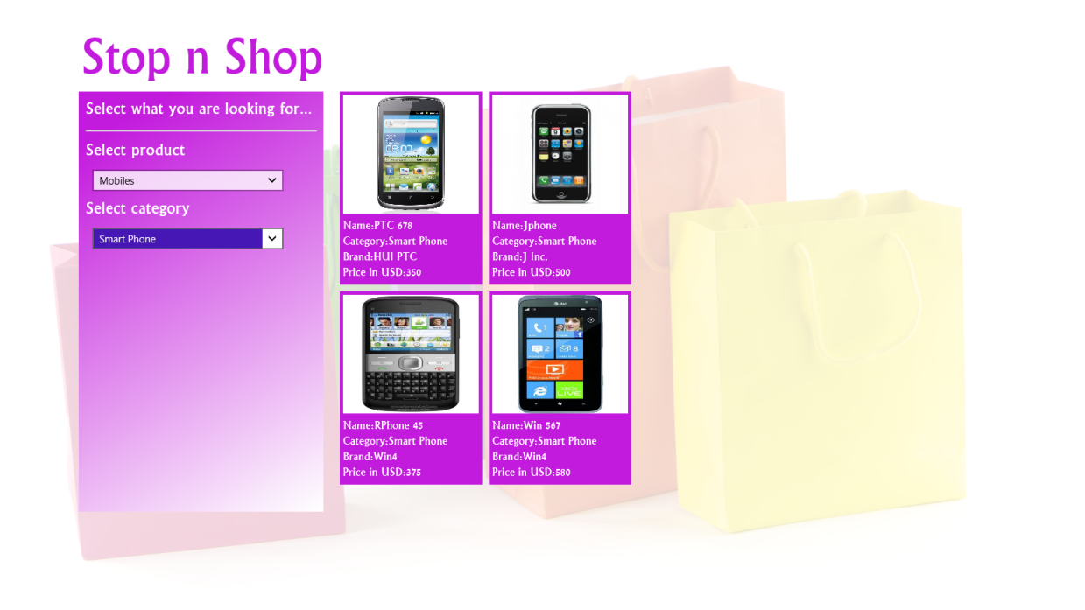
Demo: Saving and Restoring Session Data (Contd.)
    Narrow down the search results by selecting the category of the selected product type, as shown in the following figure.
Notes:
10

Slide 11
Demo: Saving and Restoring Session Data (Contd.)
  Ryan noticed that when he is searching for a particular product, if the app is terminated by OS when it is in the suspended state, the app starts from the beginning. However, the app should continue from where Ryan left.
  Help Ryan to implement the preceding functionality.
Notes:
11

Slide 12
Demo: Saving and Restoring Session Data (Contd.)
  Solution:
  To implement the required functionality in the app, Ryan needs to perform the following tasks:
    1. Save the session data of the Home page.
    2. Restore the session data of the Home page.
    3. Execute the app and verify the output.
Notes:
12

Slide 13
Summary
  In this session, you learned that:
  To save the session data, you can write the code in the oncheckpoint event handler of the default.js file.
  To restore the session data, write the code within the onactivated event handler of the default.js file, for the apps created by using the Blank App template.
Notes:
13

Slide 14

Q&A

